Slide 1

Product Recommendation System for E-Commerce using Collaborative Filtering and Textual Clustering
Team :
V.Chakradhar Reddy
G.Deepak Pavan
M.A.Waseem Shoaib
Internal Guide : Mr. Nageswara Rao (Asst.prof)

Slide 2
Content
Introduction
Problem Statement
Background
Proposed Solution
Future Work
Conclusion

Slide 3
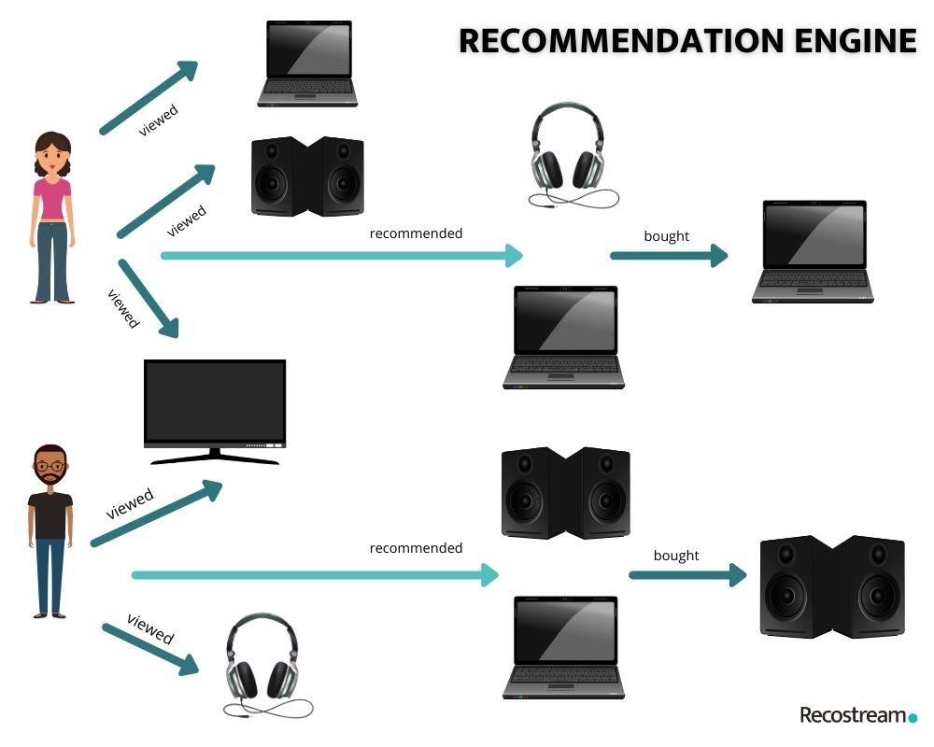

Introduction

Slide 4
Problem Statement
Providing related content out of relevant and irrelevant collection of items to users.
Product Recommendation System aims to recommend products to users based on user-items (item) ratings.
The recommendation system can be used by new and existing users

Slide 5
System: : Pentium i3 Processor or higher Hard Disk : 500 GB. Monitor: 15’’ LED Input Devices: Keyboard, Mouse RAM: 4 GB
Hardware and Software requirements
Jupyter notebook
MERN
SciPy library
NumPy
Scikit-learn
Pandas

Slide 6
Functional Requirements
Required libraries need to be imported.
Admin Login and Registration
View ratings and orders by customers.
Recommendations must be appropriate.
Non-Functional Requirements
User must have a unique user name and password
Data security and scalability.
Extensibility for future conditions.

Slide 7
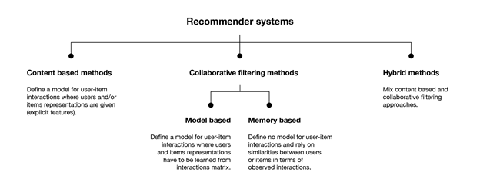
Types of recommender systems

Slide 8
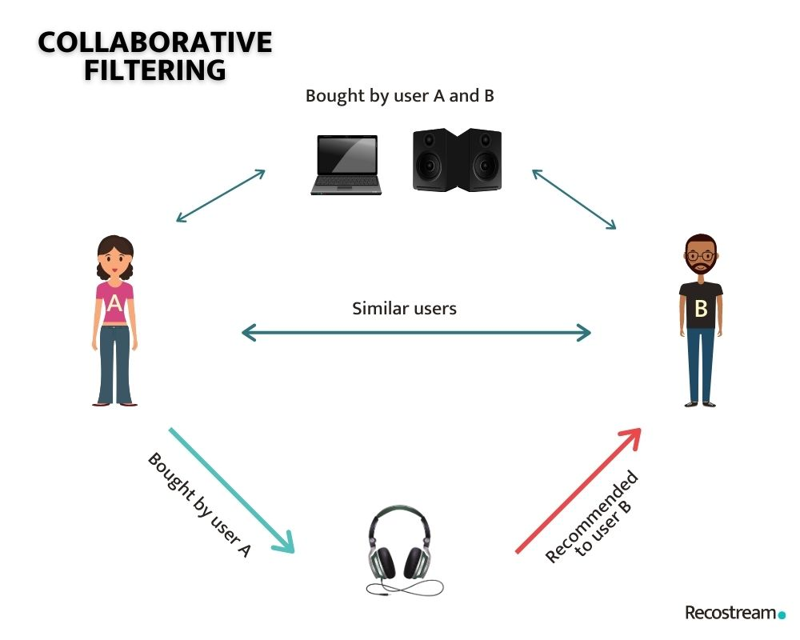
Background For the Solution
Collaborative Filtering
chooses items based on the correlation between people with similar preferences.
Rate items based on ratings of the users that rated the same items
Textual Clustering
Textual Clustering is a clustering technique to cluster text-related documents. It targets the new users as our system will be unable to get any information about the user at the very beginning but our recommendation system should show some products even then, so the user will get the recommendations related to the search he/she has done.

Slide 9
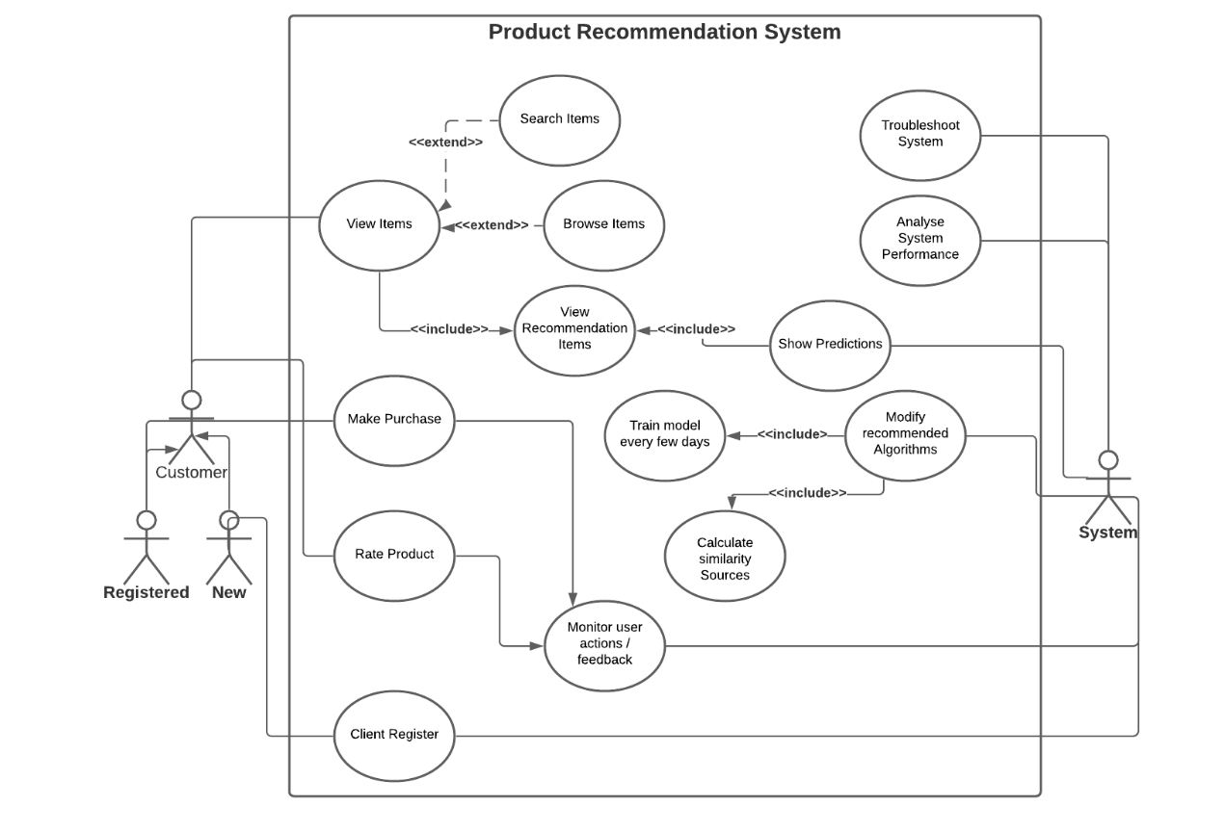
Use Case Diagram

Slide 10
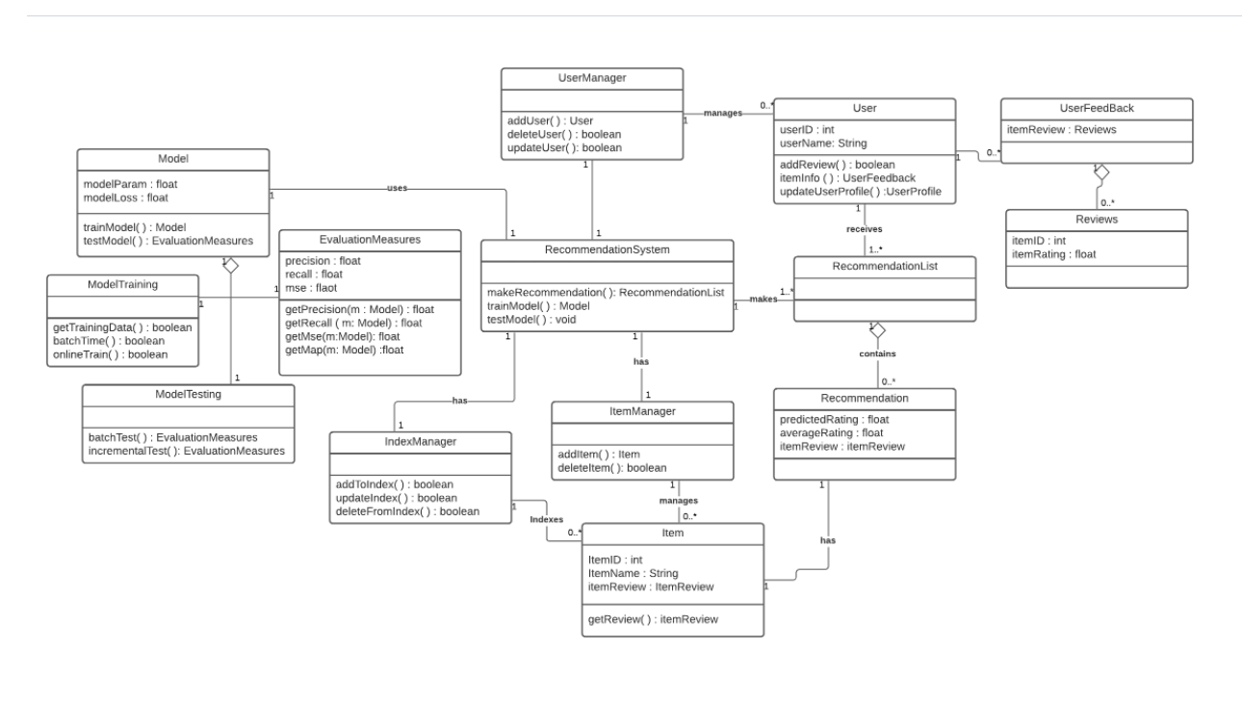
Class Diagram

Slide 11
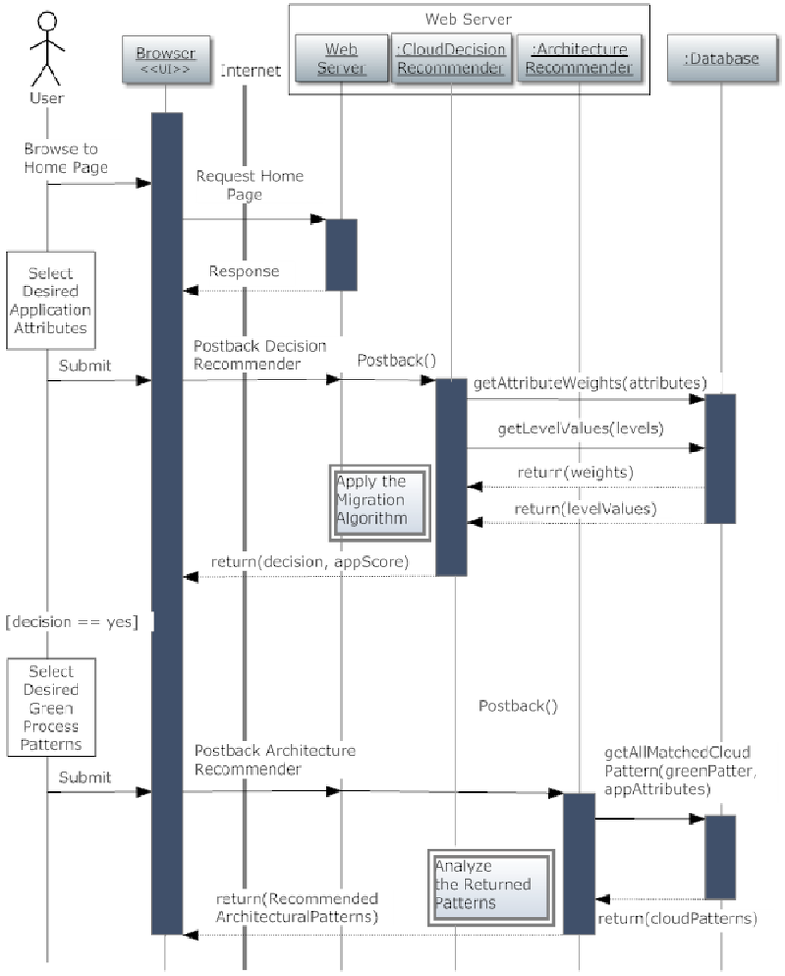
Sequence diagram

Slide 12
Future Work
K-NN method
Different values of K can be tried
Distributed processing of this problem
Distance weighting the contributions from neighbor
C-K-NN
K-Means clustering then applying K-NN
Trying different # of clusters

Slide 13

Conclusion
Recommendation systems provide content for us by taking what other people recommend as well as our selections into account.
Collaborative Filtering is a widely used solution for this problem which we make use of in our project on top of this we also use textual clustering .

